Slide 1
Disrupting Bluetooth Connections Through DoS Attacks
By: Orlando Guerra

Slide 2
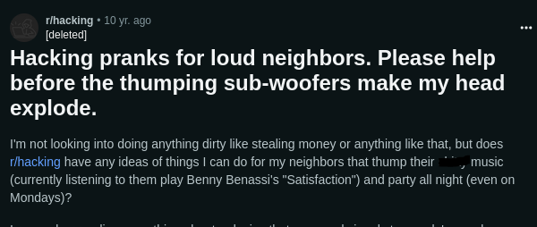
Why I Chose To Hack A Speaker
Working late at night and coming home to neighbors partying can always be a gripe
After countless articles and Youtube tutorials I was able to find and acquire the right tools

Slide 3

Legal Disclaimer
All actions using python scripts and kali tools were done on IoT devices within my own network.

Slide 4
Denial of Service or Distributed Denial of Service?
DoS Attacks
Single source device using a script or tool
Create fake traffic to flood server resources
Usually one endpoint
DDoS Attacks
Have a Command-and-Control (C2) Server
Use botnets- a collection of seized devices to distribute packets
Use real traffic on a much larger scale to overwhelm the network
Usually targets the networks connection to the internet

Slide 5
Purpose and Goals
Through developing our understanding of Network Connectivity we can
Act as a trusted network
Conduct reconnaissance and enumerate devices
Use Bluetooth vulnerabilities to deny connection to devices
We will use Windows (Host OS) Oracle VirtualBox (Virtual Machine), Kali Linux (Debian 11 Bullseye 64-bit, Virtual OS), and Bluetooth DoS Script (Python) to perform a DoS on our victim.
In this case we will be flooding traffic to a JBL Flip 6 Bluetooth Speaker.

Slide 6

How Does Bluetooth work?
Bluetooth is a 2.4GHz wireless short-range form of communication. Both WiFi and Bluetooth operate on the same frequency.
Although Bluetooth uses authentication and encryption, it only asks to pair once.
It still broadcasts a signal to nearby devices allowing for reconnaissance to take place.
As long as our device can support a bluetooth adapter we can establish a pairing.

Slide 7

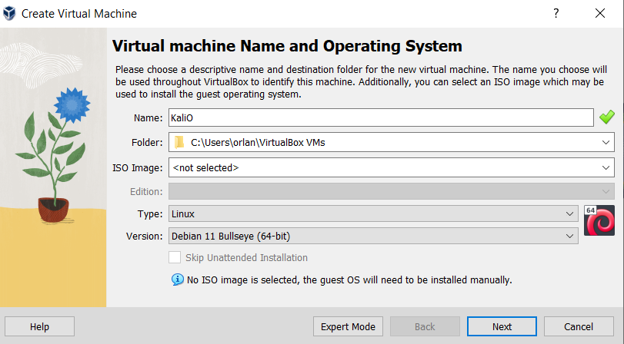
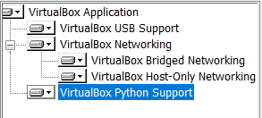
Downloading VirtualBox and Kali Linux
Downloading the latest version of VirtualBox 7.0.12. The version we will use is Debian 11 (64-bit).

Slide 8
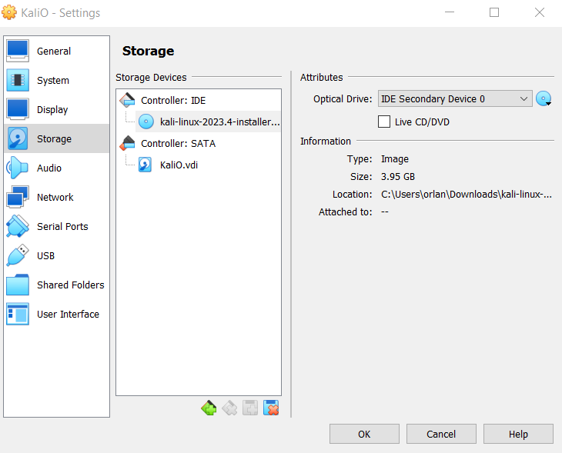
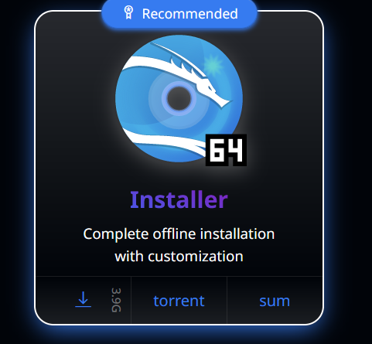
Downloading VirtualBox and Kali Linux
Downloading Kali 64-bit Installer we are able to attach this to the storage drive of our Debian machine.
Here we will update the system in command line using
“$Sudo apt update && sudo apt upgrade”.

Slide 9
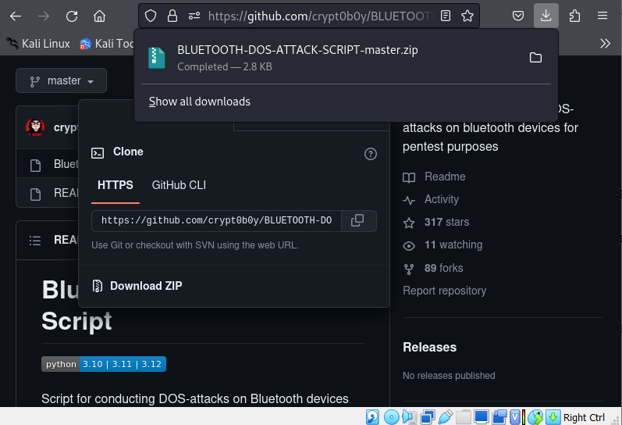
BLUETOOTH-DOS-ATTACK-SCRIPT
GitHub provides countless repositories filled with scripts
Downloading “crypt0b0ys” DoS Script or cloning them into our VirtualBox https://github.com/crypt0b0y/BLUETOOTH-DOS-ATTACK-SCRIPT
If w do not have python installed we run “$sudo apt install python3”
Unzip the script using “$sudo unzip BLUETOOTH-DOS-ATTACK-SCRIPT-master.zip”

Slide 10
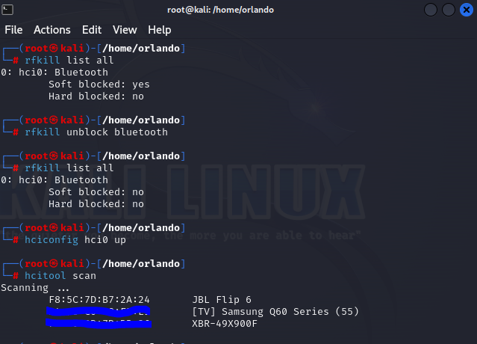
Bluetooth Adapter
Bluez- a library that provides Bluetooth layer and protocol requirements for Kali
Hcitool- configures bluetooth connections through the command line.
Using “$hciconfig -a” and “hciconfig hci0 up” to make sure our adapter is running and “$hcitool scan” we can enumerate MAC addresses.
RFKill is a subsystem in the Linux kernel that provides an interface through which radio transmitters in a computer system can be queried, activated, and deactivated

Slide 11
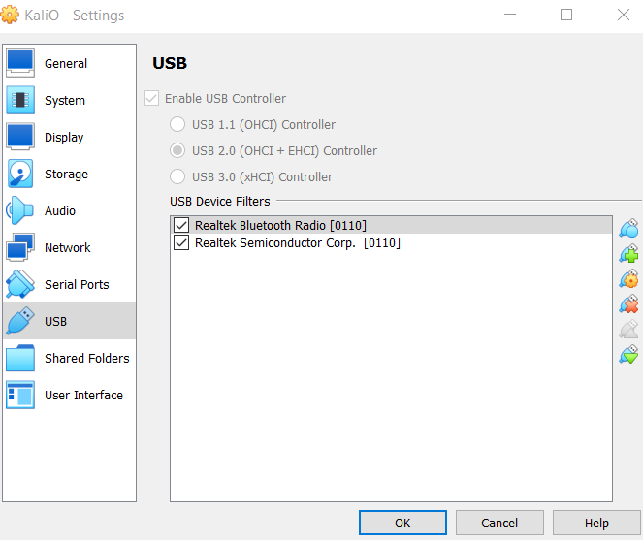
Bluetooth Adapter
By detaching our Bluetooth adapter from our Host OS (Windows) we can enable it on our VirtualBox.
We disable Bluetooth in Device Manager.
Launch Oracle VM Box.
Enable the Bluetooth adapter on Windows once again.
Enable Bluetooth Adapter on Debian.
Run “$sudo systemctl start bluetooth.service” “$sudo systemctl start bluetooth”.
Make sure Bluetooth is enabled using “$hciconfig -a”.

Slide 12
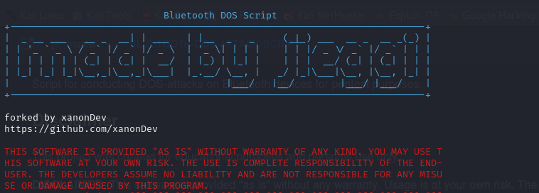
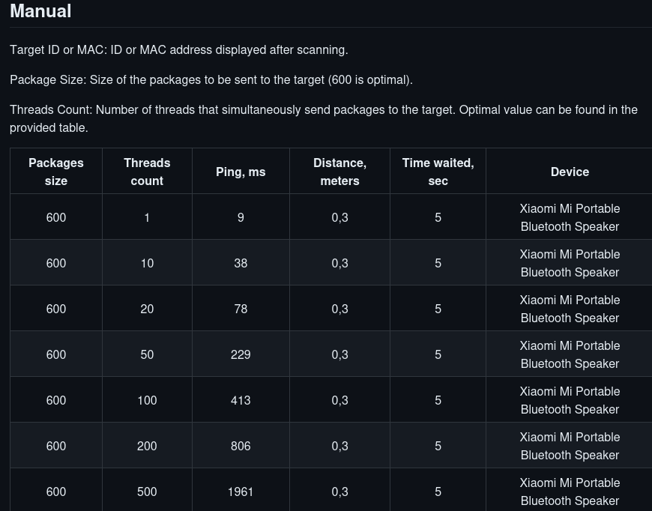
Using the Python Script
Once the script is successfully in our “/Downloads/” directory. Change directory to next directory “/BLUETOOTH-DOS-ATTACK-SCRIPT/”.
If we have already enumerated devices we know our adapter is up and running.
Run “$pthyon3 Bluetooth-DOS-Attack.py”

Slide 13
Time To Run
Although for my live presentation, a JBL speaker was the target, this can be done on any device on the FHSS (Frequency Hopping Spread Spectrum). For this recording I DoS’d another Bluetooth Adapter “BLK”.
https://clipchamp.com/watch/AzF1MzgVyKZ

Slide 14

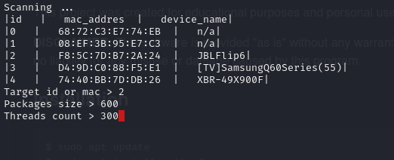
Result
Connection to the device has been rendered useless due to too much traffic.
The commands of this script are fairly simple using the manual provided.

Slide 15

Mitigation
Turning off discoverability of your devices when not in use.
Regular updates of Bluetooth firmware and software.
Be cautious of pairing requests.
Implementing SSP (Secure Simple Pairing) such as PIN numbers.
Use the FHSS (Frequency Hopping Spread Spectrum) to enable Frequency Hopping for reduced interference.

Slide 16

En Fin
“Linux is only free if your time has no value”
-Jamie Zawinski

